Slide 1
Data Exploration
Using the dplyr package

Slide 2
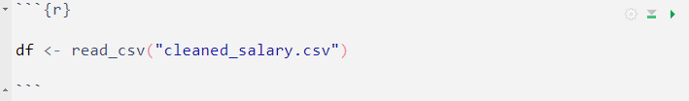
Data exploration is the process of analyzing and understanding a dataset to gain insights into its characteristics, patterns, and relationships. The main objective of data exploration is to get a sense of the data's distribution and variability before proceeding to more formal analysis or modeling.
In the subsequent section, we will conduct an exploration of the prepared salary dataset using several fundamental functions available in the `dplyr` package such as:
select()
distinct()
count()
filter()
mutate()
summarise()
group_by()

Slide 3
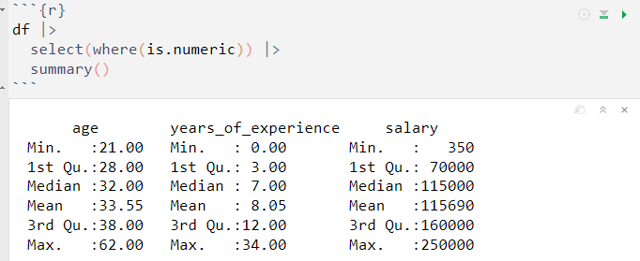
select()
The select function basically allows us to choose a set of columns or variables we want to see or work with.
With the this function, we can swiftly generate a descriptive summary for all numeric variables in our dataset by following these steps:
Employ the select() and where() function from the dplyr package to choose only numeric variables.
Extract a descriptive summary, which includes the minimum, median, mean, quantile, and maximum, utilizing the summary() function.

Slide 4
From the previous analysis, we observe the following:
The average age of workers in the salary dataset is 33.6 years, with the youngest being 21 years old and the oldest 62 years old.
Regarding salaries, the average is $115,690, with some workers earning as little as $350, while others earn up to $250,000.
As for years of experience, the maximum is 34 years, and on average, workers have approximately 8 years of experience.

Slide 5
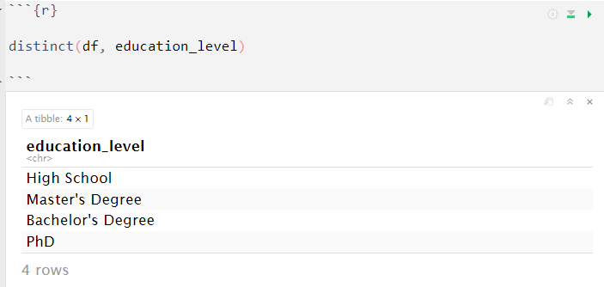
distinct()
The distinct function can be utilized to remove duplicate records, retaining only unique records.
In this case, we will utilize the distinct() function to obtain the unique education levels for each employee.
The output indicates that the dataset includes education levels ranging from "High School" to "PhD"

Slide 6
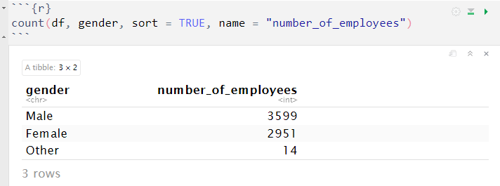
count()
The count() function efficiently provides us with the number of occurrence of each unique value for one or more variables.
By using the count() function, we can obtain the count of employees for each gender in our dataset.
The summary output shows that there are 3,599 male employees, which is more than the number of female employees (2,951), while the remaining genders consist of only 14 employees in total.

Slide 7
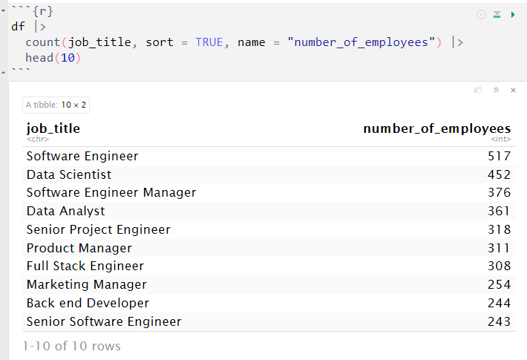
Using the count() function, we can also retrieve the ten most frequently occurring job titles in the salary dataset.
The output indicates a higher representation of tech-related jobs in the data compared to non-tech related jobs.

Slide 8
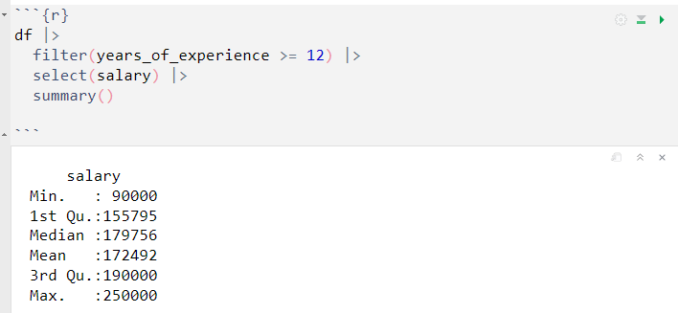
filter()
The filter() function is used to extract rows from a dataset that meet specific conditions or criteria.
With the filter() function, we can selectively extract the records of employees who have 12 and above years of experience and then calculate the descriptive summary of their salaries.
When we take a look at the output, we can observe that employees with 12 years and above of experience have as average salary of 172,492, which is higher than the overall average of 115,690.

Slide 9
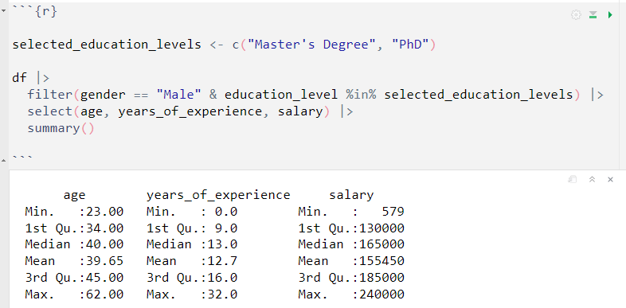
Filtering by multiple criteria
The filter() function can also allow you to filter the data to only include rows that meet multiple conditions simultaneously. You can use the logical operators such as & (AND) and | (OR) to combine conditions.
For example, suppose we want to obtain the descriptive summary of employees who are male and have attained either a Master's Degree or PhD, we can achieve this by performing the following:

Slide 10
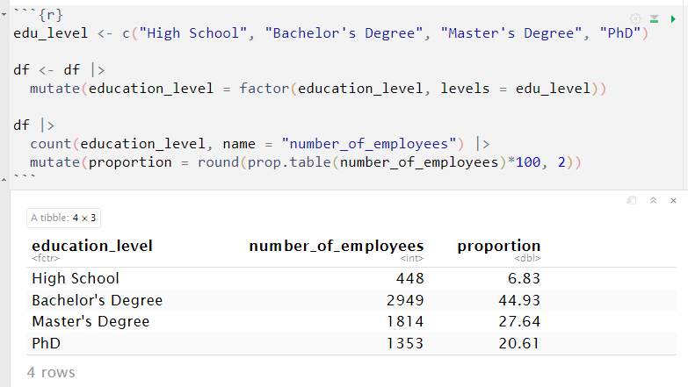
mutate()
The mutate() function is used to create or modify columns (variables) in a dataset. It allows you to add new variables based on existing ones or perform calculations to transform the data in a flexible and straightforward manner.
To begin using the mutate() function, we can convert the "education_level" variable data type to a factor, effectively creating an ordered level of unique values when presenting a summarized version of the variable.
As expected, the largest proportion (> 44%) of employees in our dataset hold a "Bachelor's Degree", with "Master's Degree" and "PhD" holders following behind.

Slide 11
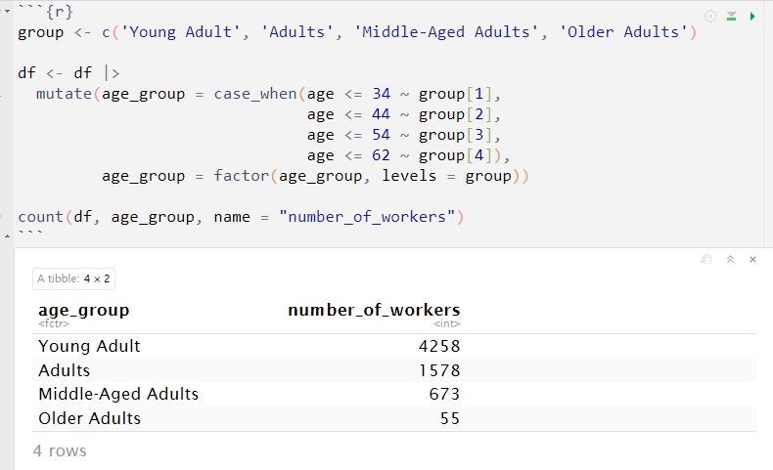
To categorize employees into several age groups, we can use a combination of the mutate() function and case_when() function. Additionally, we will ensure that the data type is set to a factor to facilitate the ordering process.
A large portion of the total employees in our dataset consists of "Young Adult". we can also observe a pattern indicating that as employees' age increases, their representation in the current data decreases.

Slide 12
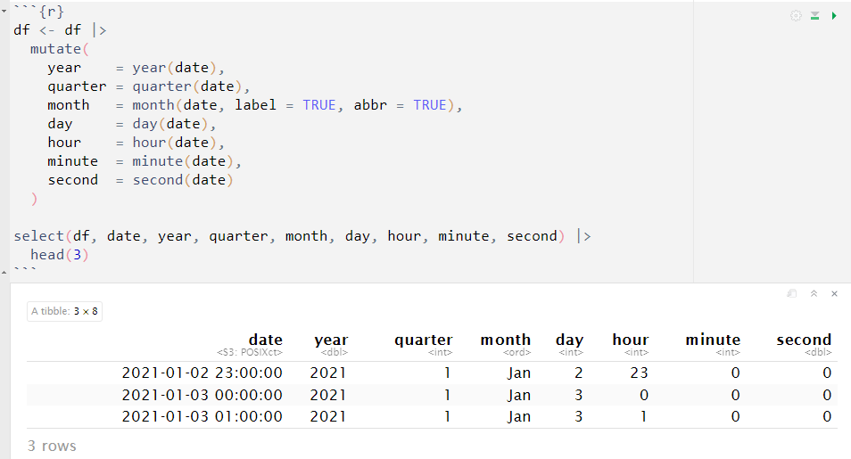
When dealing with a date variable, we can extract several key component to conducts a more precise analysis based on a particular period. These components comprise the year, quarter, month, day, hour, minute and seconds.
For our dataset, we will separate these components into different columns using various functions from the lubridate package.

Slide 13
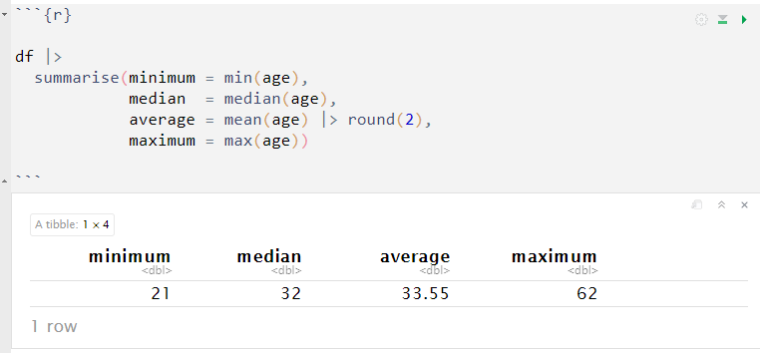
summarise()
The summarise() function is used to calculate and aggregate values for one or more variable (or grouped variable) in a dataset.
We can rewrite the aggregate summary we conducted earlier in the analysis by using the summarise() function.
The summarise() function offers greater flexibility, allowing you to control the number of aggregations, the number of variables involved, the naming conventions, and more.

Slide 14
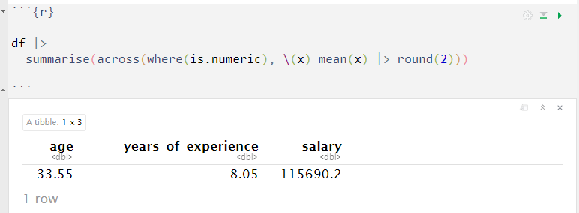
By utilizing the across() function, we can summarize multiple numeric variables simultaneously.
The code above performs a summary across all columns that contain numeric data, computing the average and rounding the result to two decimal places.

Slide 15
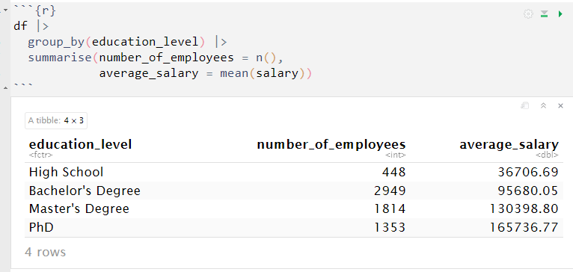
group_by()
The group_by() function in dplyr is used to group a dataset based on one or more variables. Once the data is grouped, you can apply functions and calculations to each group independently.
To determine the average salary for each education level, we will employ the group_by() function in conjunction with the summarise() function. This will allow us to create groups based on education level and then calculate the average salary within each group.
The output provides a clear representation of the average salary distribution based on education level, showing a positive correlation between higher education levels and higher average salaries.

Slide 16
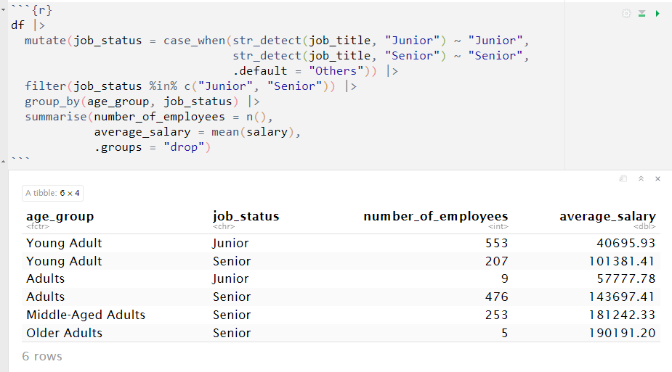
Using the group_by() function we can also summarise the average salary based on the employee's age group and their job status as juniors or seniors.
To accomplish this, we will first create a new variable called "job_status" to indicate whether an employee is a junior, senior, or falls into another category. Then, we will filter the dataset to include only employees within the junior and senior group. Finally, we will calculate the average salary based on the employee's age group and "job status".
The summary reveals a notable distinction between employees in junior and senior roles concerning their salaries. As anticipated, junior roles have a lower average salary compared to senior roles.

